Slide 1

Operating Systems Design( 19CS2106S) Session-7 Low-Level File System Algorithms (Internal Representation of Files)

Slide 2

Session Plan

Slide 3
Learning Outcomes
To understand low level file system algorithms ialloc, ifree and alloc.
To explore the above algorithms in xv6 as case study.
To understand the design and implementation of fs.c

Slide 4
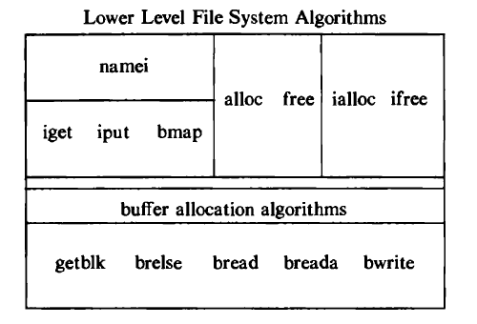
Review of Session-6

Slide 5
Review of Session-6-inode
inode stands for index node.
In Unix based operating system each file is indexed by a number called inode(index node) or inode number.
It’s a name of a file in the form a number.
The inode contains the information necessary for a process to access a file, such as file ownership, access rights, file size, and location of the file's data in the file system.
inode contains the table of contents to locate a file's data on disk.
Also called as disk inode.

Slide 6
Review of Session-6- Concept of in-core inode
When the file is opened, then the kernel copies the inode(disk inode) into main memory area called inode cache, just like the buffer cache.
So, this copy of disk inode present in MM is called as in-core inode.
As the file changes, the in-core inode is updated usually more often than the on-disk copy.
The in-core inode contains up-to-date information on the state of the file
This is allocation is done using iget algorithm

Slide 7
Review of Session-6- iget Algorith
iget algorithm allocates an in-core copy of an inode
It is almost identical to the algorithm getblk for finding a disk block in the buffer cache.
Here, The kernel maps the device number and iode number into a hash queue and searches the queue for the inode.
If it cannot find the inode, it allocates one from the free list and locks it.
The kernel then prepares to read the disk copy of the newly accessed inode into the in-core copy.

Slide 8
Review of Session-6-iput Algorithm
iput algorithm is used to release the inodes
When the kernel releases an inode ,it decrements its in-core reference count.
If the count drops to 0, the kernel writes the inode to disk if the in-core copy differs from the disk copy.
They differ if the file data has changed, if the file access time has changed, or if the file owner or access permissions have changed.
Now, the kernel places the inode on the free list of inodes, effectively caching the inode in case it is needed again soon.

Slide 9
bmap Algorithm
To convert logical byte offset of a file to a physical disk block.

Slide 10
Review of Session-6-namei Algorithm
namei algorithm is used for the conversion of a path name to an inode.
It follows a pathname until a terminal point is found.
In this algorithm ,it uses intermediate inodes as it parses a path name; call them working inodes.
The inode where the search starts is the first working mode.
During each iteration of the namei loop, the kernel makes sure that the working inode is indeed that of a directory.
Otherwise, the system would violate the assertion that non-directory files can only be leaf nodes of the file system tree.

Slide 11
Session-7
Low Level File System Algorithms
ialloc & ifree
alloc & free

Slide 12
Lets start with concept of Super Block
When a partition or disk is formatted, the sectors in the hard disk is first divided into small groups. This groups of sectors is called as blocks.
The block size is something that can be specified when a user formats a partition.
The most simplest definition of Superblock is that, its the metadata of the file system.
Similar to how i-nodes stores metadata of files, Superblocks store metadata of the file system

Slide 13
Super Block
A request to access any file requires access to the filesystem's superblock.
If its superblock cannot be accessed, a filesystem cannot be mounted (i.e., logically attached to the main filesystem) and thus files cannot be accessed.
The Super block contains an array to cache the numbers of free inodes in the file system.

Slide 14
Fields of Super Block
size of the file system,
the number of free blocks in the file system,
a list of free blocks available on the file system,
the index of the next free block in the free block list,
the size of the inode list,
the number of free inodes in the file system,
a list of free inodes in the file system,
the index of the next free inode in the free mode list,
lock fields for the free block and free inode lists,
a flag indicating that the super block has been modified.

Slide 15
ialloc Algorithm
ialloc algorithm allocates new inodes to various processes.
We know that , the Super Block contains new free inodes.

Slide 16
ialloc Algorithm
The kernel first verifies that no other processes have locked access to the super block free inode list.
If the list of inode numbers in the super block is not empty, the kernel assigns the next mode number, allocates a free in-core inode for newly assigned disk inode using algorithm iget (reading the inode from disk if necessary), copies the disk inode to the in-core copy, initializes the fields in the inode, and returns the locked inode.

Slide 17
ialloc Algorithm
If the super block list of free inodes is empty, the kernel searches the disk and places as many free inode numbers as possible into the super block.
The kernel reads the inode list on disk, block by block, and fills the super block list of inode
numbers to capacity, remembering the highest-numbered inode that it finds.
Call that inode the "remembered" inode;
it is the last one saved in the super block.

Slide 18
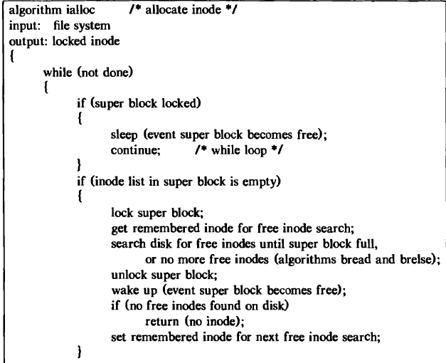
ialloc Algorithm

Slide 19
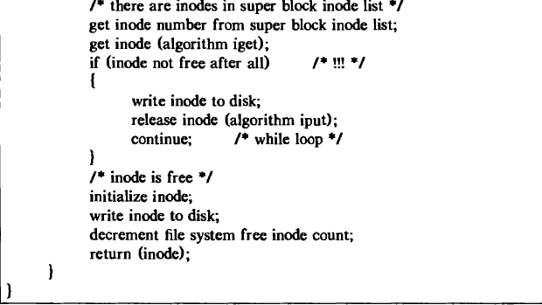
ialloc Algorithm

Slide 20
ifree Algorithm
After incrementing the total number of available inodes in the file system, the kernel checks the lock on the super block.
If locked, it avoids race conditions by returning immediately: The inode number is not put into the super block, but it can be found on disk and is available fo reassignment.

Slide 21
ifree Algorithm
If the list is not locked, the kernel checks if it has room for more inode numbers and, if it does, places the inode number in the list and returns.
If the list is full, the kernel may not save the newly freed mode there: It compares the number of the freed inode with that of the remembered inode.
If the freed inode number is less than the remembered inode number, it "remembers" the newly freed inode number, discarding the old remembered mode number from the super block.

Slide 22
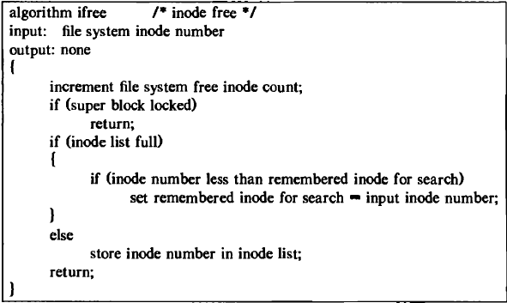
ifree Algorithm

Slide 23
Allocation & Free of Disk Blocks
When a process writes data to a file, the kernel must allocate disk blocks from the file system for direct data blocks and, sometimes, for indirect blocks.
The file system super block contains an array that is used to cache the numbers of free disk blocks in the file system.
This allocation can be done using alloc algorithm

Slide 24
alloc Algorithm
When the kernel wants to allocate a block from a file system, it allocates the next available block in the super block list.
Once allocated, the block cannot be reallocated until it becomes free.
If the allocated block is the last available block in the super block cache, the kernel treats it as a pointer to a block that contains a list of free blocks.

Slide 25
alloc Algorithm
It reads the block, populates the super block array with the new list of block numbers, and then proceeds to use the original block number.
It allocates a buffer for the block and clears the buffer's data (zeros it).
The disk block has now been assigned, and the kernel has a buffer to work with.
If the file system contains no free blocks, the calling process receives an error

Slide 26
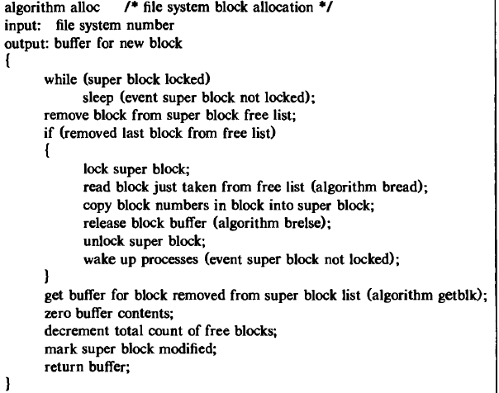
alloc Algorithm

Slide 27
free Algorithm
The algorithm free for freeing a block is the reverse of the one for allocating a block.
If the super block list is not full, the block number of the newly freed block is placed on the super block list.
If, however, the super block list is full, the newly freed block becomes a link block; the kernel writes the super block list into the block and writes the block to disk.
It then places the block number of the newly freed block in the super block list: That block number is the only member of the list.

Slide 28
Xv6 Case Study:ialloc, itrunc, balloc, bfree Functions

Slide 29
ialloc: xv6 Case Study
To allocate a new inode (for example, when creating a file), xv6 calls ialloc.
This function was mentioned at line no.5204 of xv6 code sheet no.52 of file fs.c

Slide 30
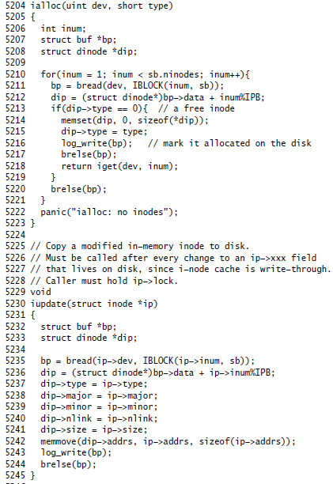
Xv6 function of ialloc

Slide 31
balloc & bfree in xv6
xv6’s block allocator maintains a free bitmap on disk, with one bit per block.
A zero bit indicates that the corresponding block is free; a one bit indicates that it is in use.
The block allocator provides two functions: balloc allocates a new disk block, and bfree frees a block.

Slide 32
The loop in balloc at (5022) considers every block, starting at block 0 up to sb.size, the number of blocks in the file system.
It looks for a block whose bitmap bit is zero, indicating that it is free.
If balloc finds such a block, it updates the bitmap and returns the block.

Slide 33
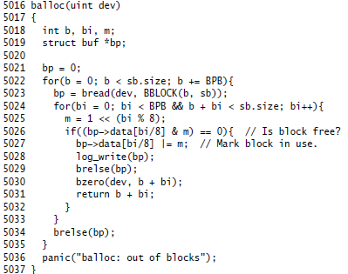
Xv6 function of balloc

Slide 34
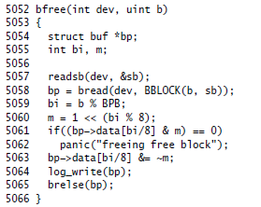
bfree (5052) finds the right bitmap block and clears the right bit

Slide 35
itrunc
itrunc frees a file’s blocks, resetting the inode’s size to zero.
itrunc (5456) starts by freeing the direct blocks (5462-5467), then the ones listed in the indirect block (5472-5475), and finally the indirect block itself (5477-5478).

Slide 36
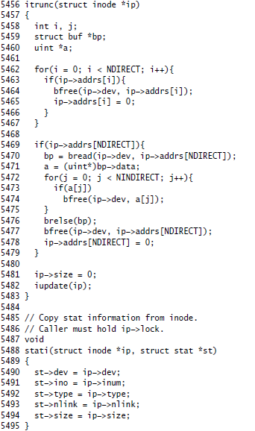
Xv6 function of itrunc

Slide 37
Design and implementation of Algorithms in fs.c

Slide 38
fs.c
fs.c is the file that consists of the xv6 functions of file system implementations.
fs.c exists from code sheets 49-57 in xv6 code sheet manual.

Slide 39
File system implementation: Five layers:
Blocks: allocator for raw disk blocks.
Log: crash recovery for multi−step updates.
Files: inode allocator, reading, writing, metadata.
Directories: inode with special contents (list of other inodes!)
Names: paths like /usr/rtm/xv6/fs.c for convenient naming

